Slide 1
Diploma in Electrical Engineering
BA in Management(Econs)
MA in Marketing Management
Own a SPA concept and design company
Dec’13 Started Unfranchise Business
Multiple times MUFO qualifier
Multiple times SABP qualifier
Motives Challenge award
MASG Local Coordinator
JERRY TAY T G
SLC member
Certified Trainer
Supervising Coordinator
≥ S$9,375 in commission/4-week

Slide 2
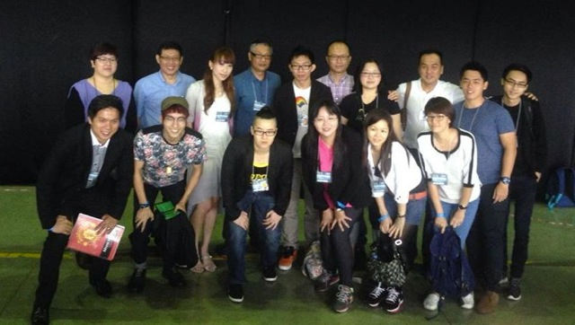
My First MA Convention – Taiwan April 2014
Brought 5 Partners
One SMC Two MC One EC

Slide 3
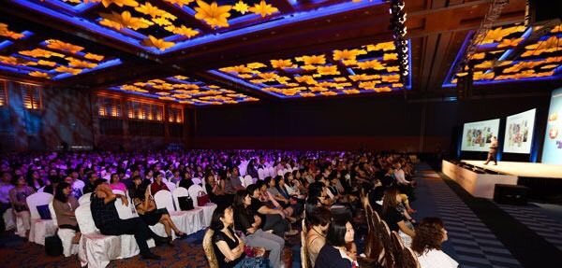
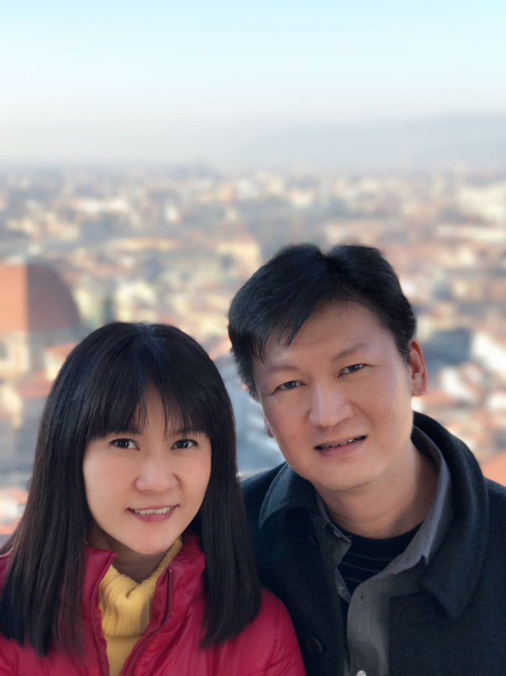
Asia Pacific Regional Convention – November 2015
Cindy Lee
& William Low
Started on Feb 2014
First Convention Nov’15
EC in Feb ‘16
MC in Aug’16
SMC in Mar’17

Slide 4
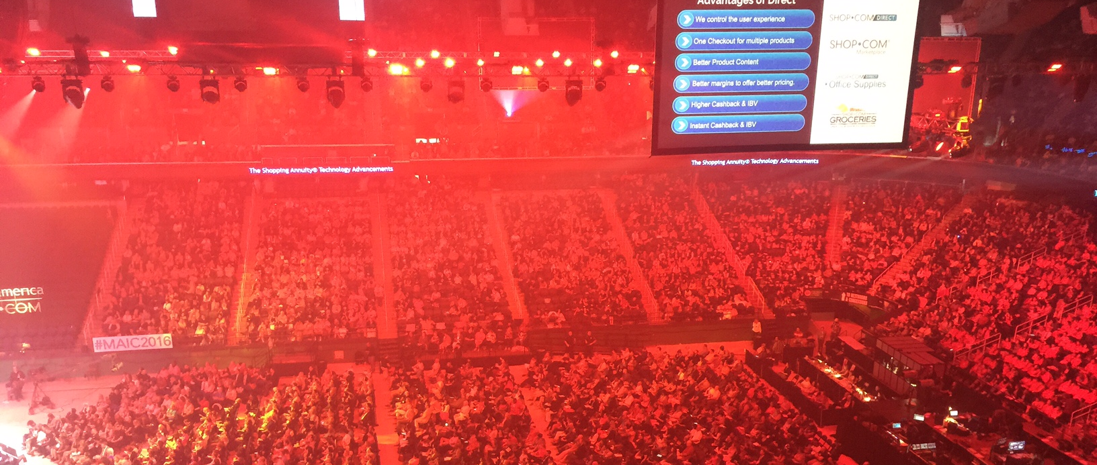
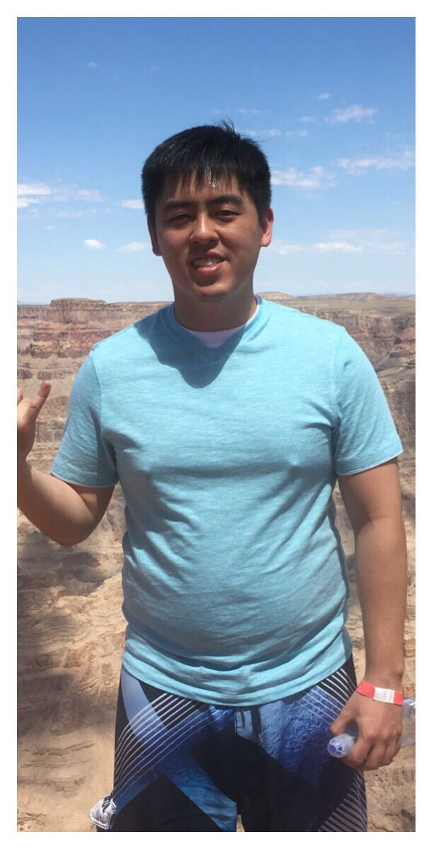
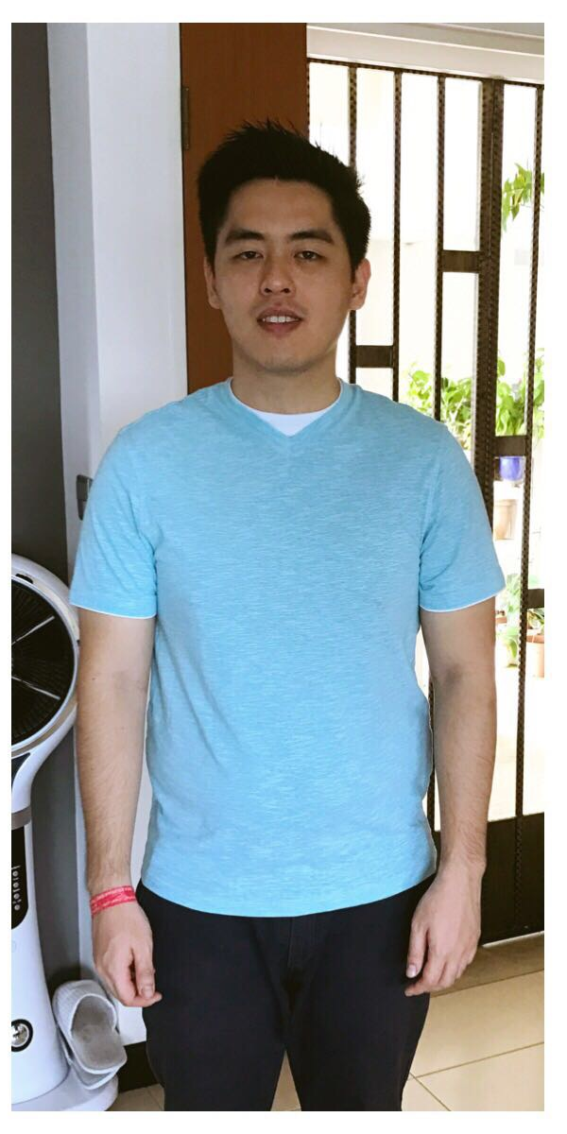
MA International Convention – Greensboro Aug 2016
Kevin Neo
Started in Jan 2014
EC in Jun 2014
MC in Dec 2014
SMC in Mar 2017
After MAIC’16

Slide 5
Power of Duplication
BV + BV = INCOME
INCOME + LEARNING = LEADER
LEADER + LEADERS = RESIDUAL INCOME + TIME FREEDOM

